Slide 1
Territory and Quota Planning Post-Gen Exercises
Updated March 2026

Slide 2
Key Objectives
Load Core Datasets to Data Hub
Initialize Spoke Model
Initialize Target Setting
Cascade Targets throughout SDH

Slide 3
Load Core Datasets to Data Hub

Slide 4
Core data objects can be loaded directly into the data schemas defined during configuration process
Accounts
Employees
Territories
Opportunities / Opportunity Lines
The Data Hub does generate pre-defined import actions. However, it is just as easy to import your own files directly to corresponding lists / modules

Slide 5
WORKING TIME
Load the core datasets to the Data Hub in their respective lists / modules using "TQ Exercise Data Hub" model
Accounts
Employees
Territories
Opportunities / Opportunity Lines
  For this exercise, can use the same opportunity line file to load headers (with no data) and then lines (with data)

Slide 6
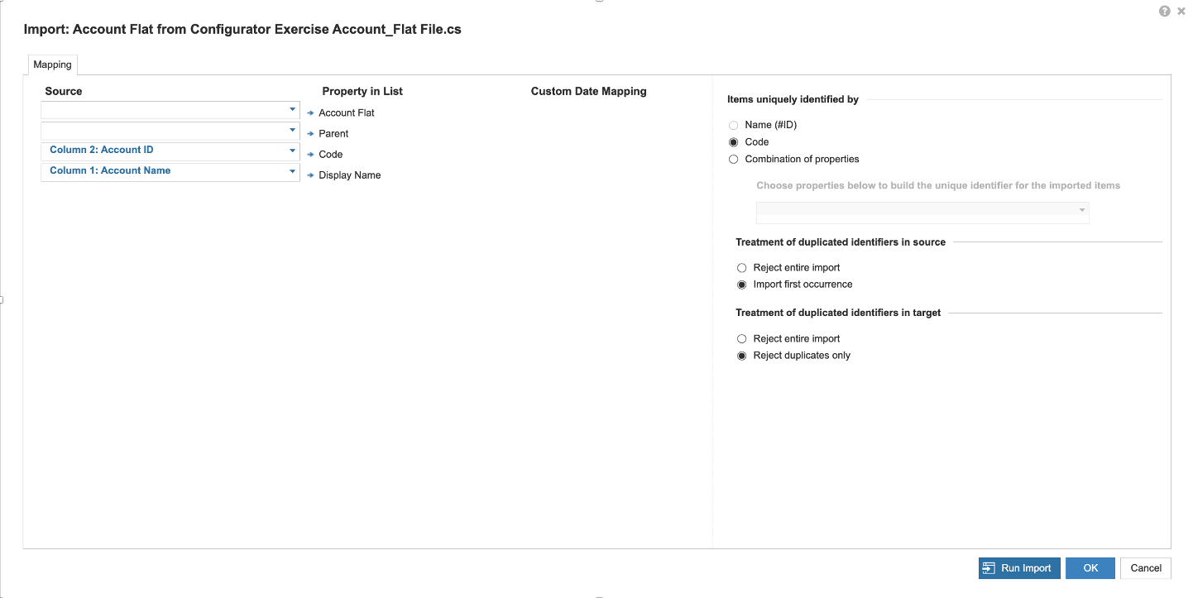
Load "Account Flat" list

Slide 7
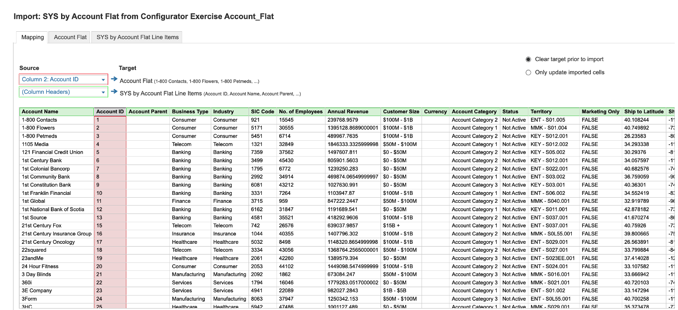
2. Load "SYS by Account Flat" module

Slide 8
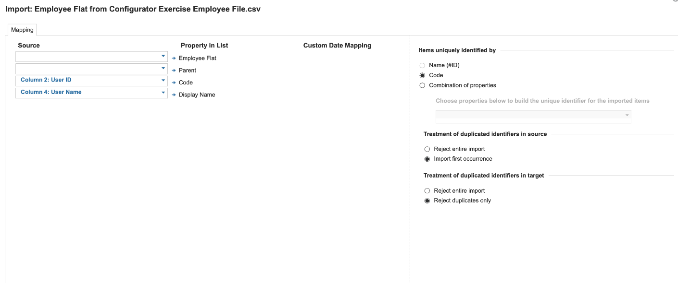
3. Load "Employee Flat" list

Slide 9
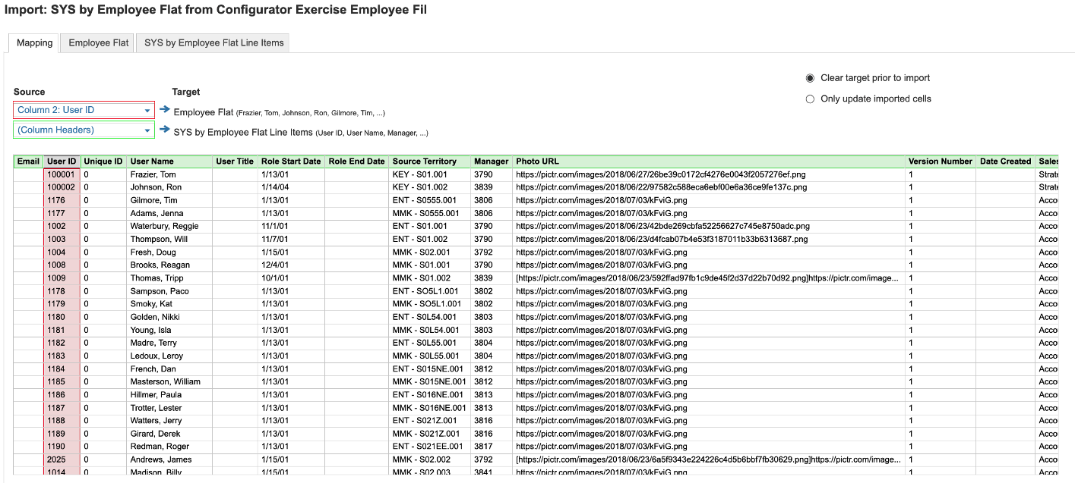
4. Load "SYS by Employee Flat" module

Slide 10
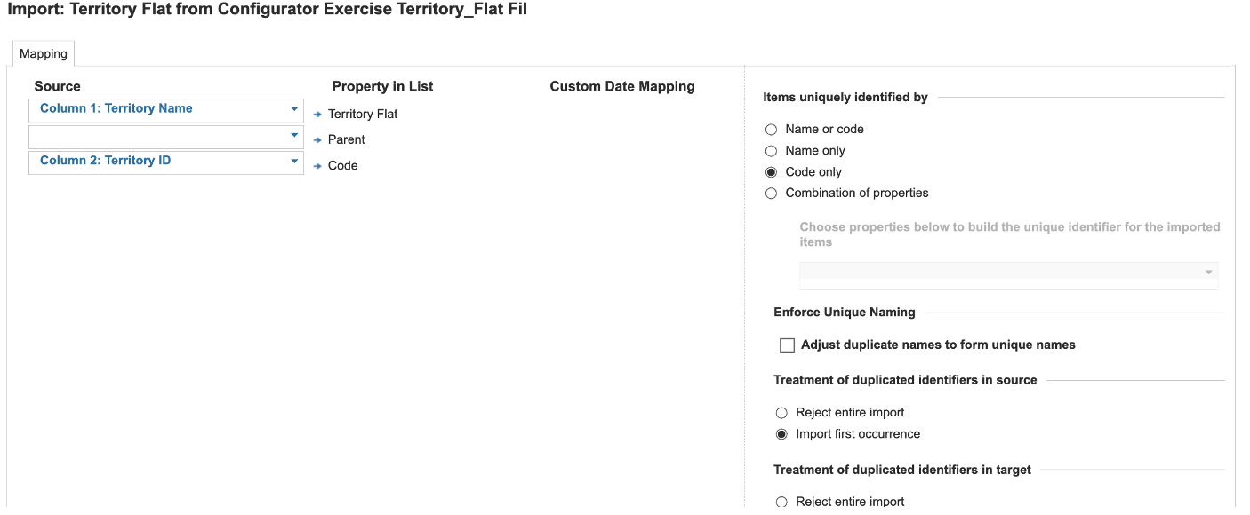
5. Load "Territory Flat" list

Slide 11
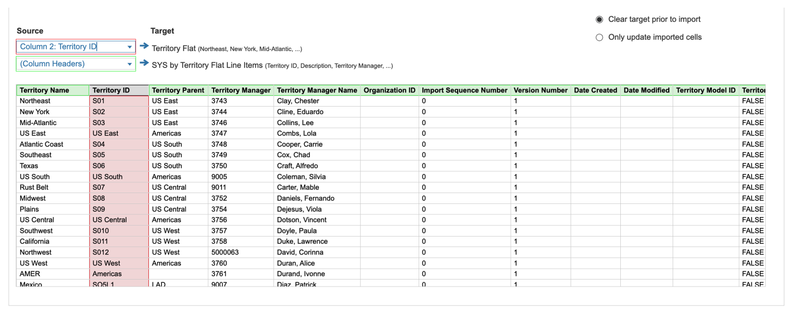
6. Load "SYS by Territory Flat" module

Slide 12
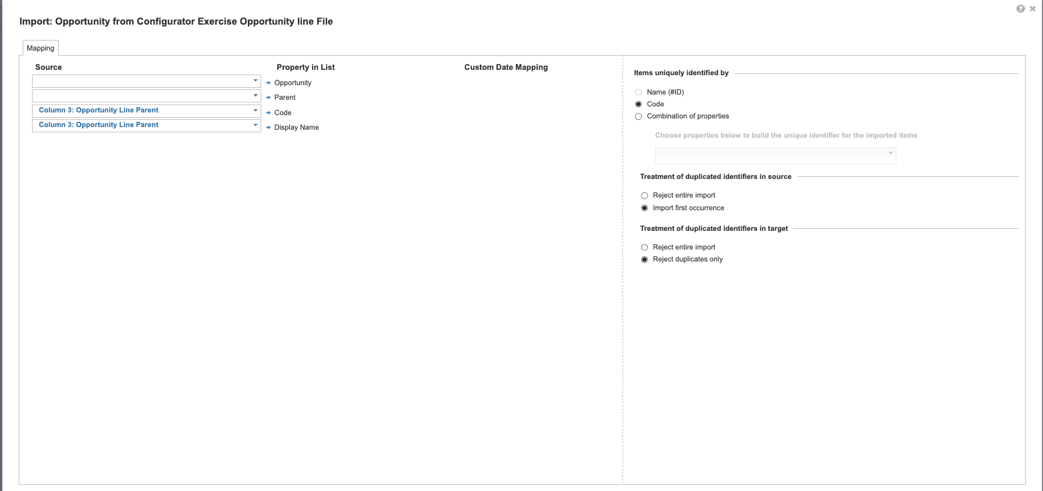
7. Load "Opportunity" list

Slide 13
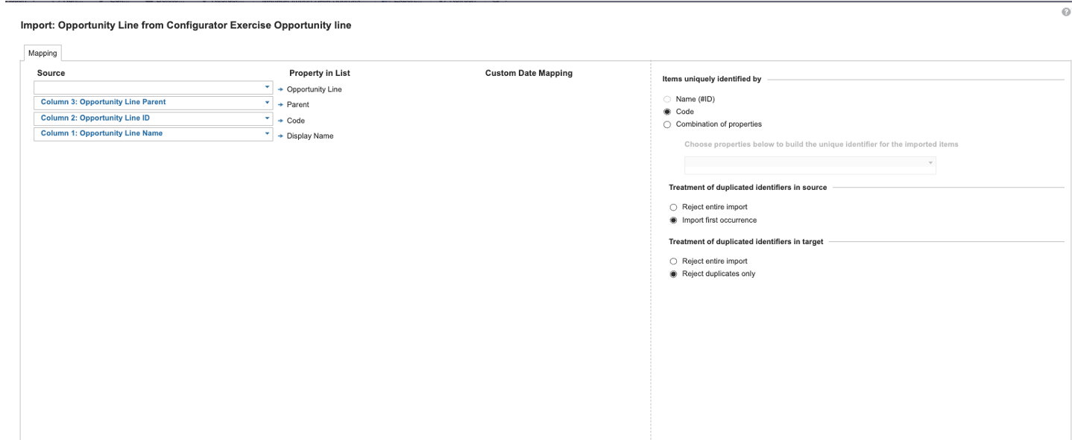
8. Load "Opportunity Line" list

Slide 14
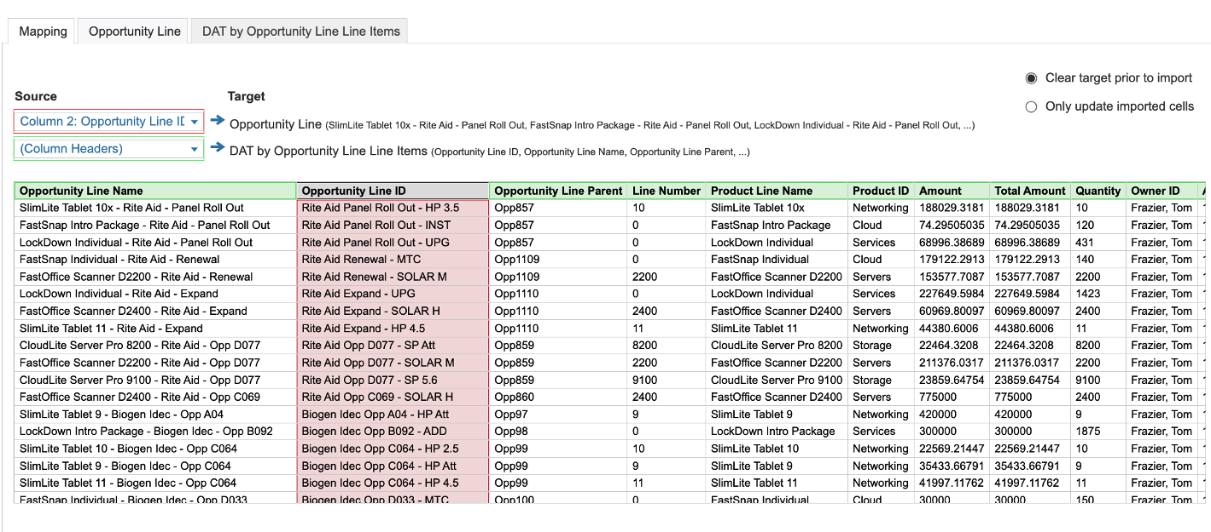
9. Load "DAT by Opportunity Line" module

Slide 15
Initialize Spoke Model

Slide 16

Data Hub – TQ Spoke model actions are pre-configured after generation. Use the "TQ Exercise Spoke" model
Run the following processes to move data:
  1.8 – Initialize Accounts
  1.9 - Initialize Territory Flat
  1.10 – Initialize Employees
  1.4 – Create Terr hierarchy
  1.2 – Import Opportunities
  2.5 – Account to Territory
  2.6 – Employee to Territory
  *Note, there will be import errors due to non-complete data setup. Review for awareness, but no need to fix/address

Slide 17
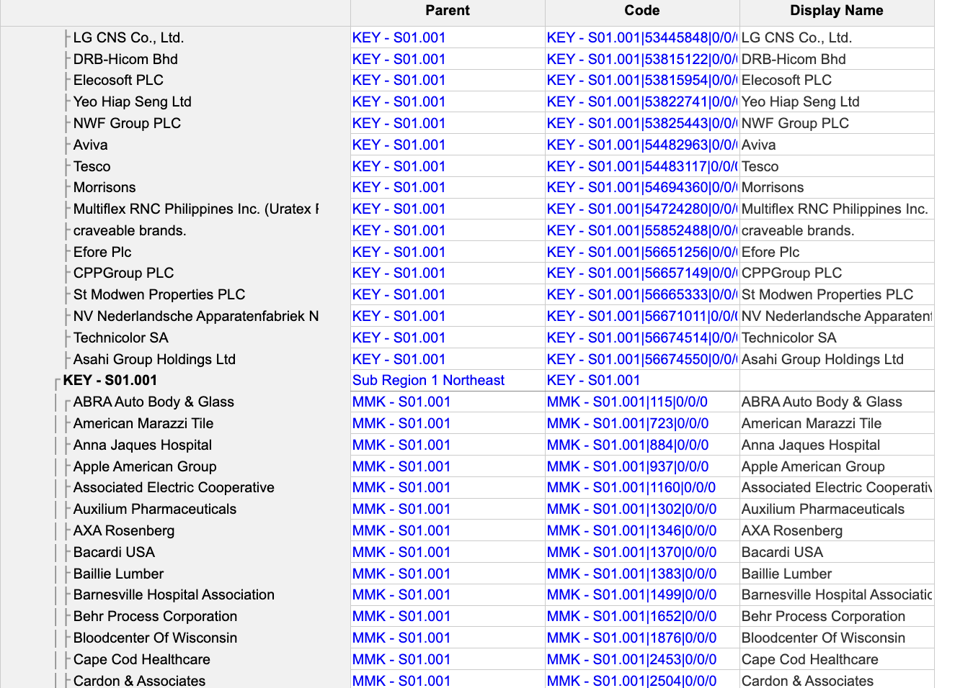
Data Validations – Account to T6 Territory

Slide 18
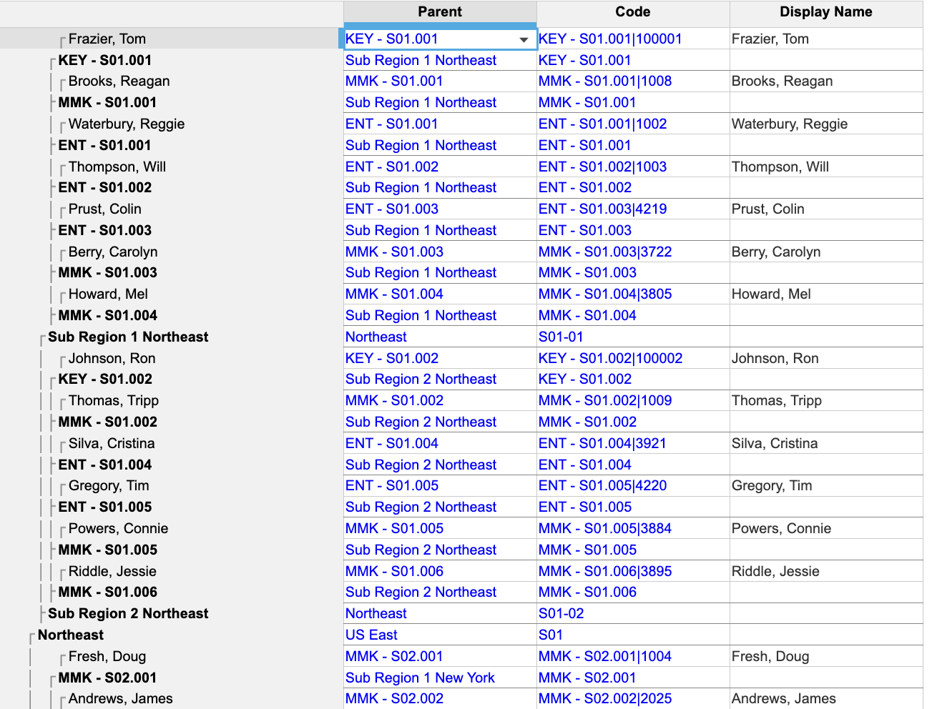
Data Validations – Employee to T6 Territory

Slide 19
Initialize Target Setting

Slide 20
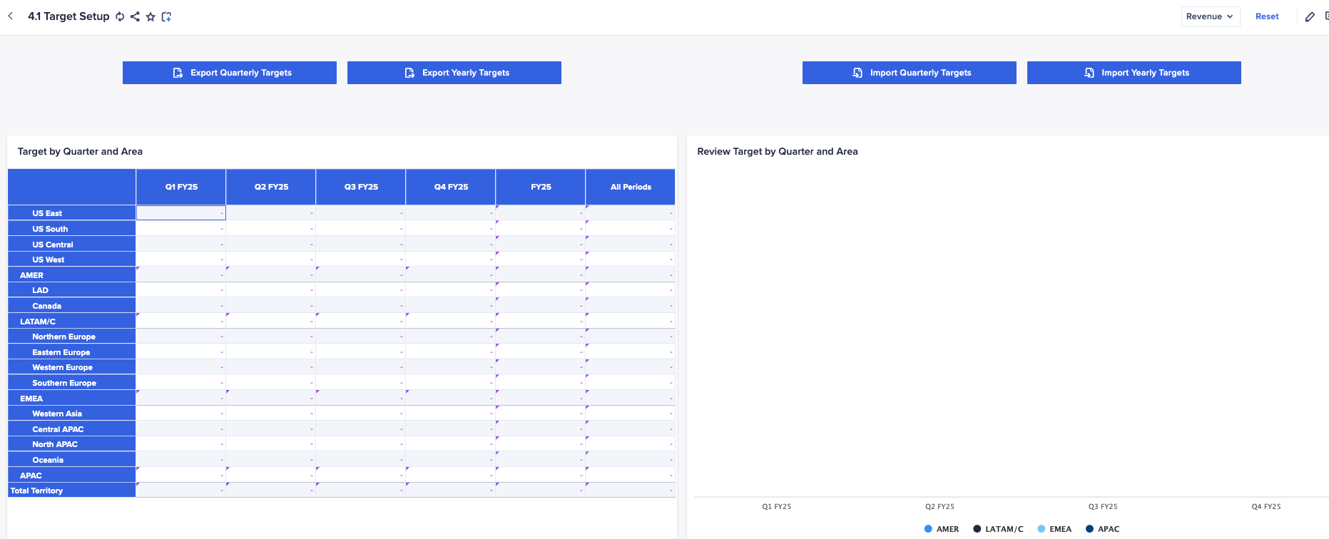
Load Targets
Load the provided “DE_Area Targets” file to load targets to the table on page ”4.1 Target Setup”

Slide 21
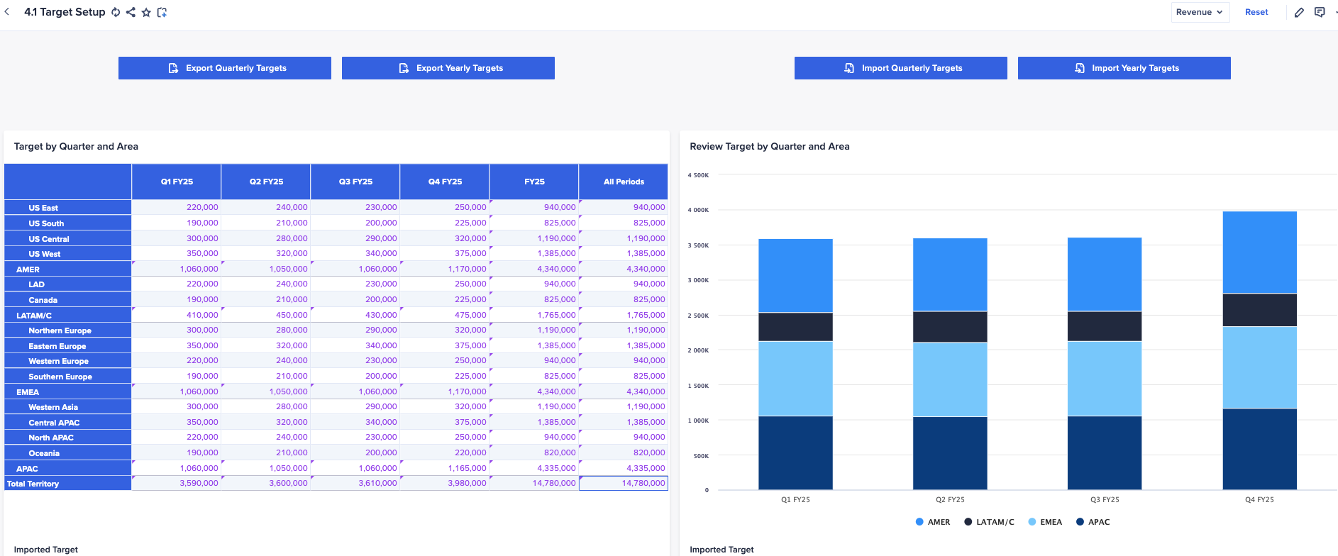
Validate Loaded Targets
*Note, data is only being loaded to the "Revenue" Planning Measure

Slide 22
Cascade Targets

Slide 23
Practice Target Cascading
Set allocation method and initial targets (4.2)
Review initial allocation / overallocation pages (4.3)
Review overallocation / override functionality (4.5)
Review bottoms-up account setting (4.7, 4.8)
*Note, will need to visit and update "Seasonality Assumptions" page in section 13

Slide 24
Additional T&Q Hands-On

Slide 25

Practice functional use of additional T&Q pages in your "TQ Demo" model
Resource Alignment
  Pages 6.1-6.3
Account Assignments
  Pages 7.1-7.3.1
Rules-based Assignments
  Pages 11.1-11.5

